Slide 1
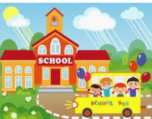
When children go back to Greytown School

Slide 2
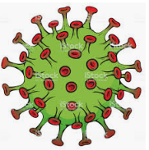

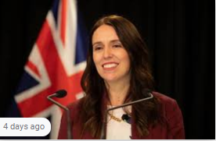
A yucky bug made people sick. It was called COVID 19.
The Prime Minister, Jacinda Ardern, told people in New Zealand to stay home. This helped to keep us safe.

Slide 3


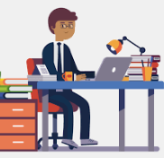
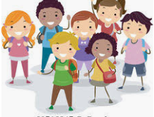
After a while, less and less people got sick. It really made a difference that people stayed at home!
Our Prime Minister, Jacinda Ardern, said people can go back to work and children can go back to school!

Slide 4


There will be some changes at school for children and teachers.
Those changes will help to keep everyone at school safe. They are good changes!

Slide 5
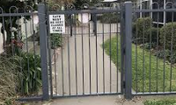
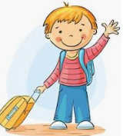
At the gates most children will say goodbye! They can hug, kiss and wave bye to their parents.
At the gate some parents will sign a paper and walk with their children to the classroom. At the classroom they can hug, kiss and wave bye to their parents.

Slide 6
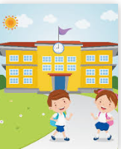


Then the children can go into their class to say hello to the teacher and their friends.
It will be different to what it used to be like. It might feel a bit weird at the beginning. That’s okay!

Slide 7
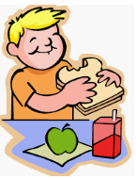
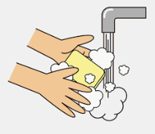
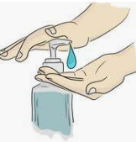
At school, everyone will be washing their hands more often. Before and after eating and of course after using the toilet!
Children and teachers will also use hand sanitizer. We will use hand sanitizer when we go into a room and when we leave a room

Slide 8
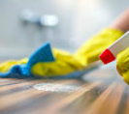
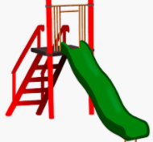
At school surfaces like tables and door handles will be regularly cleaned.
Even the playgrounds are being cleaned.

Slide 9
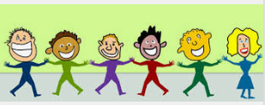
Children and adults wash their hands and use hand sanitizer to kill yucky bugs like COVID 19.
This is really important so that everyone stays healthy!

Slide 10
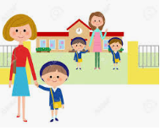
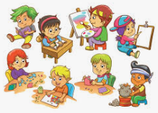
When school is finished, parents will pick children up outside the classroom or at the gate! Just like at drop off time. ☺
Children will go home and can tell their family all about their fun day at school!

